Slide 1
Analytical Instrumentation
Prof. Sujit M. Deokar,
Department of Instrumentation Engg.
Vishwakarma Institute of Technology, Pune
Lecture 04 :
Radiation & Matter

Slide 2
Recap
Atomic Orbital
Atomic Orbital: P – Orbital
Energy Levels
Periodic Table
Electromagnetism
Properties of Electromagnet Radiation
Electromagnetic Spectrum

Slide 3
Index
Transmission of Radiation
Dispersion
Diffraction
Reflection & Refraction
Snell’s Law
Polarization of Light
Prism as dispersive device
Monochromatic Slit

Slide 4
Transmission of Radiation
Two types of interactions:
Interaction of matter with the instrument components.
Interaction of the electromagnetic radiation with the sample.

Slide 5
Transmission of Radiation
The rate of propagation of electromagnetic radiation through a transparent material, such as atoms, ions, molecules and particles, is less than that of vacuum. However, frequency change will not be observed in the vacuum or elsewhere, which means that permanent energy transferred to the medium does not occur.
Therefore, the interaction involved must be only temporary deformation of the electronic clouds associated with the atoms and molecules of the order of let us say about 10⁻¹⁴ to 10⁻¹⁵ seconds. Since the velocity of radiation in the media is wavelength dependent, the refractive index of the media also must change. The variation of refractive index with wavelength is called dispersion.

Slide 6
Dispersion
What is this dispersion?
Dispersion is basically a very complex phenomena. Dispersion curves usually show two regions. One is normal dispersion in which there is a gradual increase in the refractive index with increasing frequency. Sometimes anomalous dispersion occurs at frequencies in which sharp changes occur coinciding with the natural harmonic frequency of some part of the molecule or a group of a molecule or a functional group of a molecule or of that of ion leading to the absorption of the beam.
In spectroscopy, dispersion curves are important for optical components such as lenses. So, here the most suitable components for the manufacture of lenses are those in which refractive index should be very high and it should be constant, it should not show anomalous dispersion of the electromagnetic radiation

Slide 7
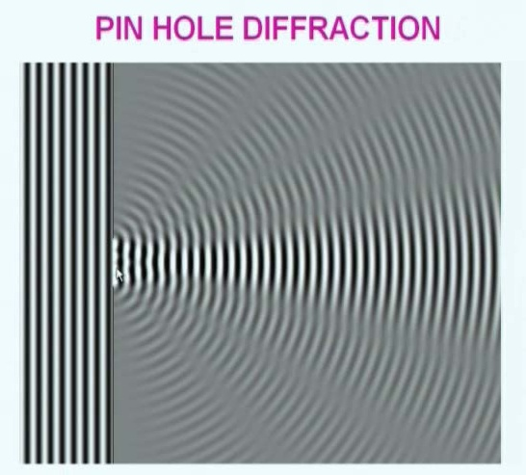
Diffraction
Diffraction refers to the bending of a parallel beam of electromagnetic radiation as it passes through a sharp barrier or a narrow opening. When a parallel beam of light is allowed to pass through a pinhole, two closely spaced pinholes are seen on a screen placed across it.

Slide 8
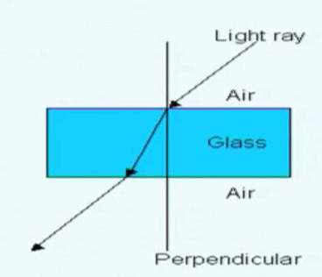
Reflection & Refraction
Mirrors –The objects in the mirror are basically reflect the radiation falling on them without any loss of the incident radiant power. Hence, they are used as optical components of a spectrum.
When the radiation passes at an angle through the interface between two media having different densities, an abrupt change in the direction occurs.

Slide 9

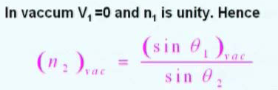
Refraction : Snell’s Law
So refraction owing to the changes in the velocity of the radiation in the two media.
So, the velocity of the radiation changes in the media.
The extent of refraction is given by Snell’s law.
Refractive indices of materials can be measured with air as one medium and available in databases.

Slide 10
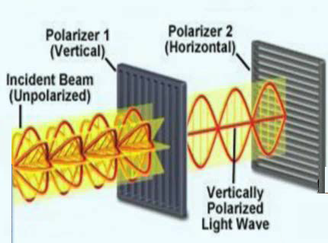
Polarization of Light

Slide 11
Polarization of Light
Ordinary radiation consists of a bundle of electromagnetic waves in which vibrations are equally distributed among huge number of planes centered along the light path of the beam.
Viewed end on it looks like an infinite set of electric vectors fluctuating from 0 to a maximum amplitude A.
The vector in any one plane say XY can be resolved into two mutually perpendicular components; Removal of the one of the two resolved planes of vibration produces a plane polarized beam. It occupies a single plane. And, radio waves emanating from antennas and microwaves produced by Klystron tube are plane polarized.
A polarized ultraviolet and visible radiation is also required. It is produced by passing the electromagnetic beam through a media that selectively absorbs or reflects or refracts that vibrates in only one plane.

Slide 12
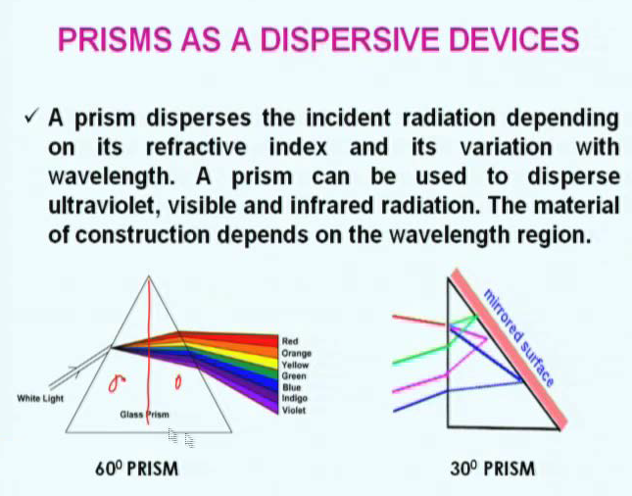

Slide 13
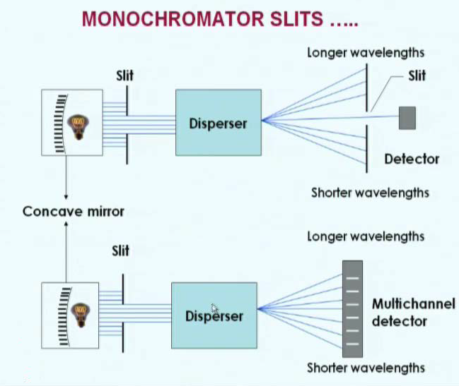
Optical Components

Slide 14
Monochromatic Slit
The slits of a monochromator basically play a very important role in determining its performance characteristics and quality. Usually, two slits are employed: one is the entrance slit, which serves as the light source and another as the exit slit on which the image is formed.
If the radiation source consists of a discrete wavelength, a series of rectangular images appears on the exit plane, which appear as bright lines corresponding to different wavelengths. Movement of the Monochromator setting in one direction or the other produces a continuous increase or decrease in the emitted intensity when the entrance slit image has moved a distance equal to it is full width.

